Slide 1
Database Design and Implementation
Lecture 7
Advanced SQL

Slide 2
Learning Outcomes
In this Lecture, the student will learn:
  How to use the advanced SQL JOIN operator syntax
  About the different types of subqueries and correlated queries
  How to use SQL functions to manipulate dates, strings, and other data
  About the relational set operators UNION, UNION ALL, INTERSECT, and MINUS

Slide 3
Agenda
This topic will cover:
  Introduction to the module
  Review of key material from level 4 Database Concepts module
  Systems Development Life Cycle(SDLC)
  Database Life Cycle (DBLC)
  Database Design
  The main phases of database design: conceptual, logical, and physical design
  Implementation
Notes:
NCC Education - Slide Master

Slide 4
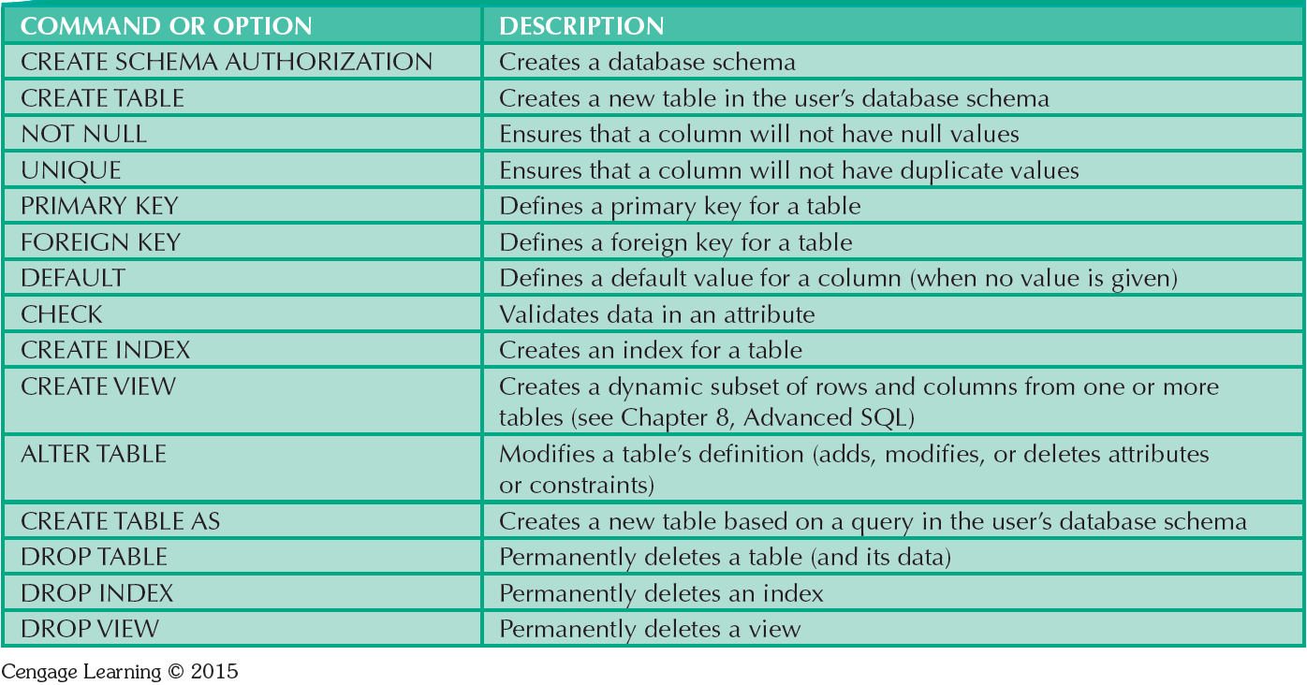
SQL Data Definition Command

Slide 5
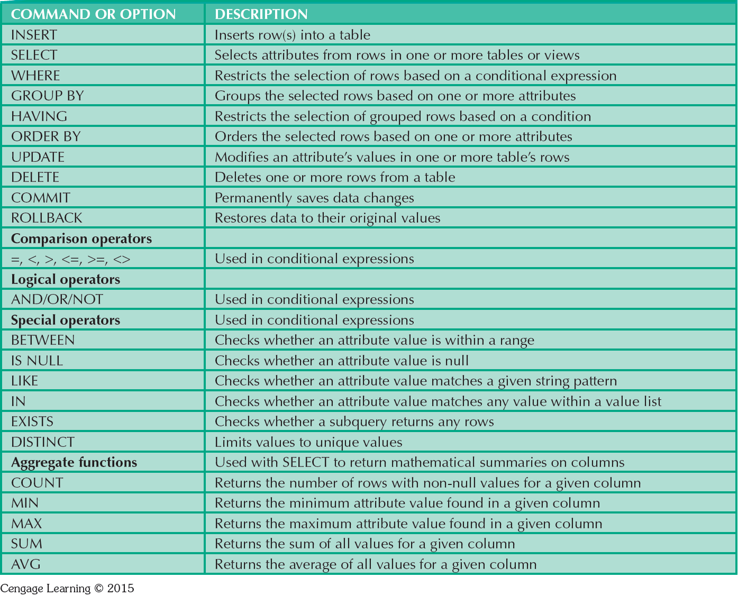
SQL Data Manipulation Commands

Slide 6
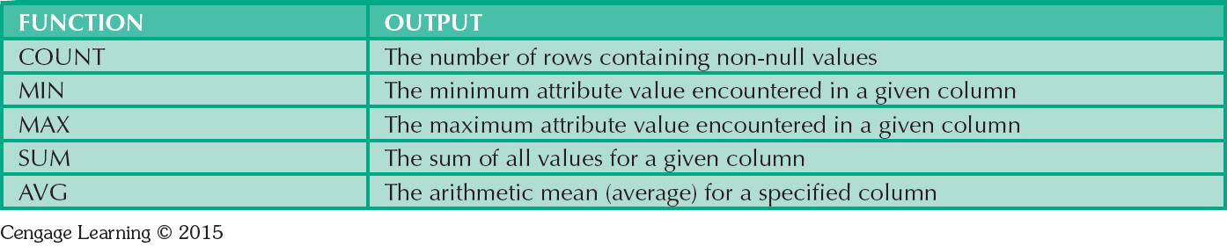
Some Basic SQL Aggerate Functions

Slide 7
Grouping Data
Frequency distributions created by GROUP BY clause within SELECT statement
Syntax - SELECT columnlist
  FROM tablelist
  [WHERE conditionlist]
  [GROUP BY columnlist]
  [HAVING conditionlist]
  [ORDER BY columnlist [ASC | DESC]];

Slide 8
HAVING Clause
Extension of GROUP BY feature
Applied to output of GROUP BY operation
Used in conjunction with GROUP BY clause in second SQL command set
Similar to WHERE clause in SELECT statement

Slide 9
Joining Database Tables
Performed when data are retrieved from more than one table at a time
  Equality comparison between foreign key and primary key of related tables
Tables are joined by listing tables in FROM clause of SELECT statement
  DBMS creates Cartesian product of every table in the FROM clause

Slide 10
SQL Join Operators
Relational join operation merges rows from two tables and returns rows with one of the following
  Have common values in common columns
  Meet a given join condition
  Have common values in common columns or have no matching values

Slide 11
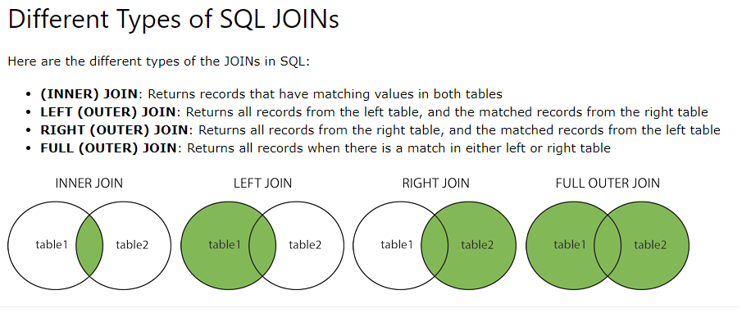

Slide 12
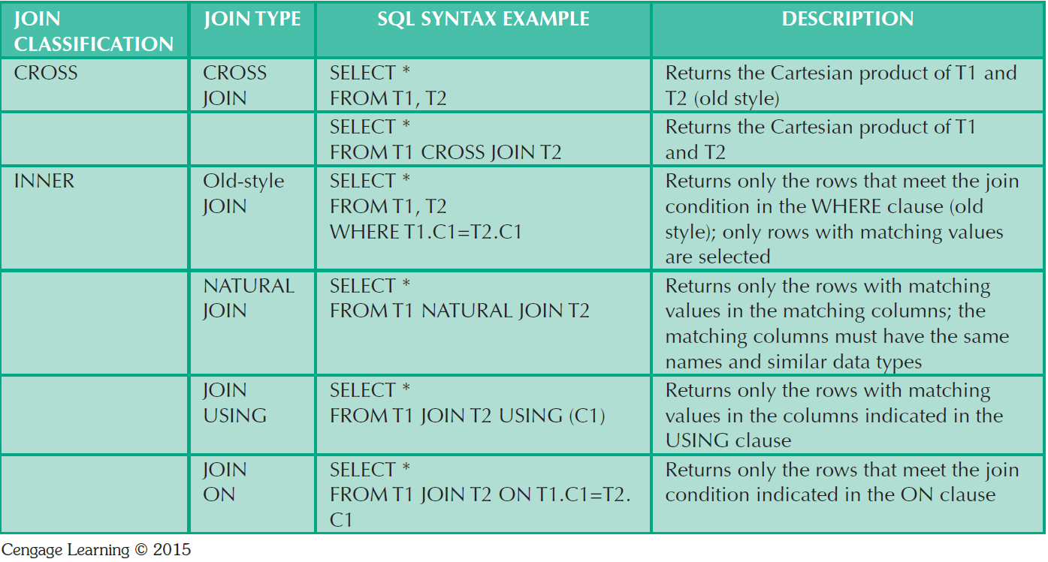
SQL Join Expression Styles

Slide 13
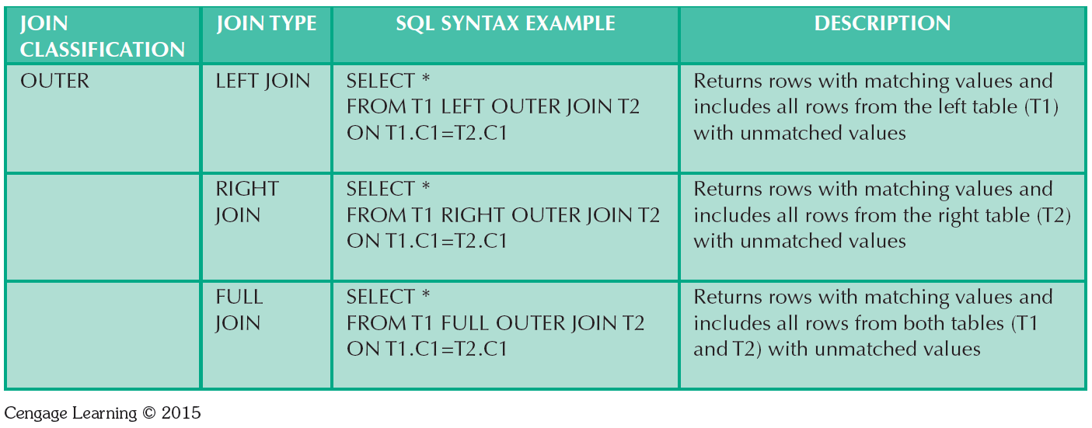
SQL Join Expression Styles

Slide 14
Subqueries
Subquery is a query inside another query
Subqueries can be used with the SELECT, INSERT, UPDATE, and DELETE statements along with the operators like =, <, >, >=, <=, IN, BETWEEN, etc.
Subquery can return:
  One single value - One column and one row
  A list of values - One column and multiple rows
  A virtual table - Multicolumn, multirow set of values
  No value - Output of the outer query might result in an error or a null empty set

Slide 15
WHERE Subqueries
Uses inner SELECT subquery on the right side of a WHERE comparison expression
Value generated by the subquery must be of a comparable data type
If the query returns more than a single value, the DBMS will generate an error
A subquery can have only one column in the SELECT clause
Can be used in combination with joins

Slide 16
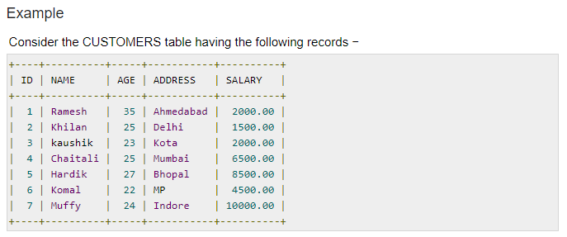

Slide 17
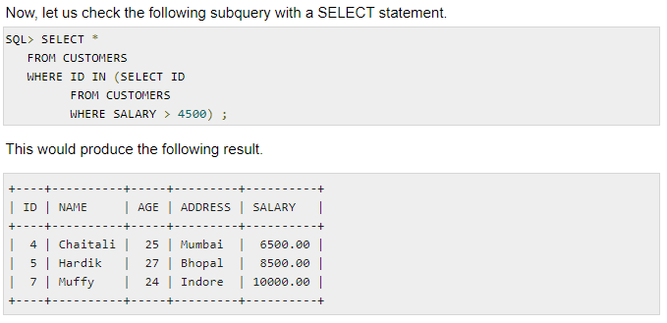

Slide 18
IN and HAVING Subqueries
IN subqueries
  Used to compare a single attribute to a list of values
HAVING subqueries
  HAVING clause restricts the output of a GROUP BY query by applying conditional criteria to the grouped rows

Slide 19
Multirow Subquery Operators:
ANY and ALL
The ANY and ALL operators are used with a WHERE or HAVING clause.
The ANY operator returns true if any of the subquery values meet the condition.
The ALL operator returns true if all of the subquery values meet the condition.
ALL operator
  Allows comparison of a single value with a list of values returned by the first subquery
    Uses a comparison operator other than equals
ANY operator
  Allows comparison of a single value to a list of values and selects only the rows for which the value is greater than or less than any value in the list

Slide 20
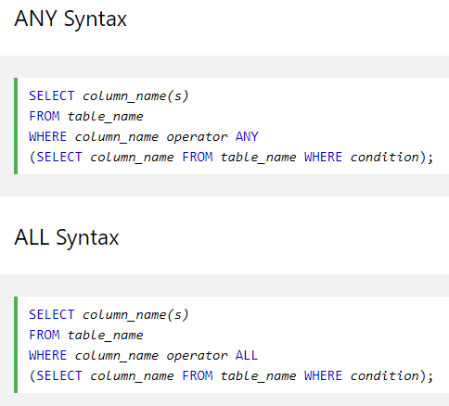
Operators
=, <>, !=, >, >=, <, or <=

Slide 21
SQL Functions
Functions always use a numerical, date, or string value
Value may be part of a command or may be an attribute located in a table
Function may appear anywhere in an SQL statement where a value or an attribute can be used
AVG() - Returns the average value.
COUNT() - Returns the number of rows.
FIRST() - Returns the first value.
LAST() - Returns the last value.
MAX() - Returns the largest value.
MIN() - Returns the smallest value.
SUM() - Returns the sum

Slide 22
SQL Functions
Date and time functions
Numeric functions
String functions
Conversion functions

Slide 23
Relational Set Operators
SQL data manipulation commands are set-oriented
  Set-oriented: Operate over entire sets of rows and columns at once
UNION, INTERSECT, and Except (MINUS) work properly when relations are union-compatible
  Union-compatible: Number of attributes are the same and their corresponding data types are alike
UNION
  Combines rows from two or more queries without including duplicate rows

Slide 24
Relational Set Operators
  Syntax - query UNION query
UNION ALL
  Produces a relation that retains duplicate rows
  Can be used to unite more than two queries
INTERSECT
  Combines rows from two queries, returning only the rows that appear in both sets
  Syntax - query INTERSECT query

Slide 25
Relational Set Operators
EXCEPT (MINUS)
  Combines rows from two queries and returns only the rows that appear in the first set
  Syntax
    query EXCEPT query
    query MINUS query
Syntax alternatives
  IN and NOT IN subqueries can be used in place of INTERSECT

Slide 26
References
Database Systems: Design, Implementation, and Management by Carlos Coronel and Steven Morris,13th Edition, Cengage, Chapter 8.
Database Systems A Practical Approach to Design, Implementation and Management by Thomas Connolly and Carolyn Begg, Sixth Edition, Pearson, Chapter 8

